Slide 1
Essentials of
Systems Analysis and Design
Sixth Edition
Joseph S. Valacich
Joey F. George
Jeffrey A. Hoffer
Chapter 3
Managing the Information Systems Project
3.1

Slide 2
Learning Objectives
Discuss skills required to be an effective project manager
Describe skills and activities of a project manager during project initiation, planning, execution and closedown
Discuss critical path scheduling
Explain Gantt Charts and Network Diagrams
Review commercial project management software packages
3.2

Slide 3
Pine Valley Furniture
Manufacturing Company
  Product: Wood Furniture
  Market: United States
  Organized into functional areas
    Manufacturing
    Sales
  Three independent computer systems were converted to a database in 1990s
3.3

Slide 4
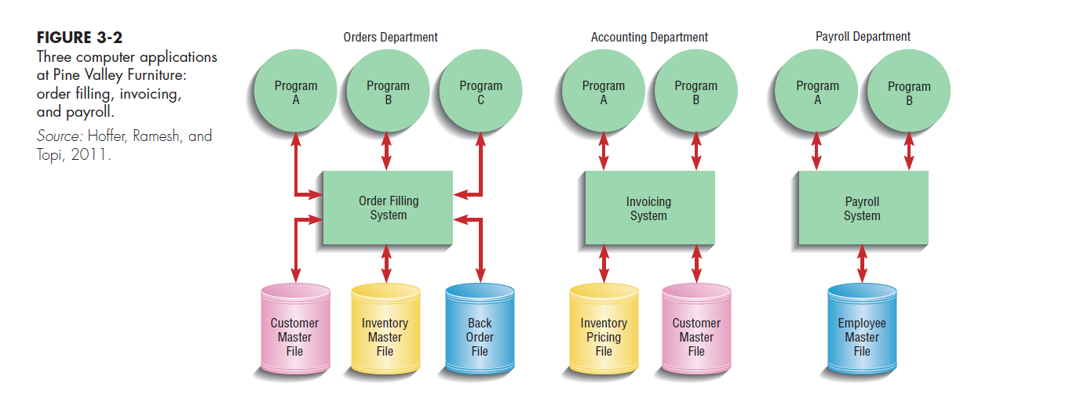
3.4

Slide 5
Managing the Information Systems Project
Focus of Project Management
  To assure that information system projects meet customer expectations
    Delivered in a timely manner
    Meet constraints and requirements
3.5

Slide 6
Managing the Information Systems Project (continued)
Project Manager
  Systems Analyst responsible for
    Project initiation
    Planning
    Execution
    Closing down
  Requires diverse set of skills
    Management
    Leadership
    Technical
    Conflict management
    Customer relations
3.6

Slide 7
3.7

Slide 8
Project Management Process
Project
  Planned undertaking of related activities to reach an objective that has a beginning and an end
Four Phases
  Initiating
  Planning
  Executing
  Closing down
3.8

Slide 9
Initiating the Project
Establish the project initiation team
Establish a relationship with the customer
Establish the project initiation plan
Establish management procedures
Establish the project management environment and workbook
Develop the project charter
3.9

Slide 10
Planning the Project
1. Describe project scope, alternatives and feasibility
  Scope and Feasibility
    Understand the project
    What problem is to be addressed
    What results are to be achieved
    Measures of success
    Completion criteria
2. Divide the project into manageable tasks
    Work breakdown structure
    Gantt chart
3.10

Slide 11
Planning the Project (continued)
Estimate resources and create a resource plan.
Develop a preliminary schedule
    Utilize Gantt Charts and Network Diagrams
5. Develop a communication plan
  Outline communication processes among customers, team members and management
  Define types of reports and their distribution
  Determine frequency of reports
3.11

Slide 12
3.12

Slide 13
Planning the Project (continued)
6. Determine project standards and procedures
  Specify how deliverables are tested and produced
7. Identify and assess risk
  Identify sources of risk
  Estimate consequences of risk
8. Create a preliminary budget
3.13

Slide 14
Planning the Project (continued)
9. Develop a project scope statement
  Describe what the project will deliver
10. Set a baseline project plan
  Estimate of project’s tasks and resources
3.14

Slide 15
Executing the Project
1. Execute baseline project plan
  Acquire and assign resources
  Train new team members
  Keep project on schedule
2. Monitor project progress
  Adjust resources, budget, and/or activities
3.15

Slide 16
Executing the Project (continued)
3. Manage changes to baseline project plan
  Slipped completion dates
  Bungled activity that must be redone
  Changes in personnel
  New activities
4. Maintain project workbook
5. Communicate project status
3.16

Slide 17
Closing Down the Project
1. Termination
  Types of termination:
    Natural
      Requirements have been met
    Unnatural
      Project stopped
  Documentation
  Personnel Appraisal
3.17

Slide 18
Closing Down the Project (continued)
2. Conduct post-project reviews
  Determine strengths and weaknesses of
    Project deliverables
    Project management process
    Development process
3. Close customer contract
3.18

Slide 19
Representing and Scheduling Project Plans
Gantt Charts
  Useful for depicting simple projects or parts of large projects
  Show start and completion dates for individual tasks
Network Diagrams
  Show order of activities
3.19

Slide 20
3.20

Slide 21
Comparison of Gantt Charts and Network Diagrams
Gantt Charts
  Visually show duration of tasks
  Visually show time overlap between tasks
  Visually show slack time
Network Diagrams
  Visually show dependencies between tasks
  Visually show which tasks can be done in parallel
  Show slack time by data in rectangles
3.21

Slide 22
Representing Project Plans
Network diagramming is a critical path scheduling technique
Used when tasks
  Are well-defined and have a clear beginning and end point
  Can be worked on independently of other tasks
  Are ordered
  Serve the purpose of the project
Major strength is ability to show how completion times vary by activity
3.22

Slide 23
Gantt Chart and Network Diagram for Pine Valley Furniture
Steps
  1. Identify each activity
    Requirements collection
    Screen design
    Report design
    Database construction
    User documentation creation
    Software programming
    Installation and testing
3.23

Slide 24
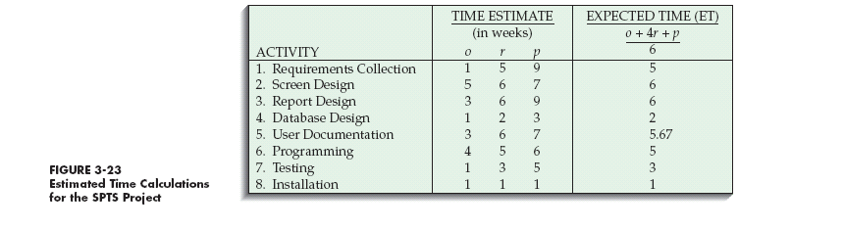
Gantt Chart and Network Diagram for Pine Valley Furniture (continued)
  2. Determine time estimates and expected completion times for each activity
3.24

Slide 25
Gantt Chart and Network Diagram for Pine Valley Furniture (continued)
  Determine sequence of activities
3.25

Slide 26
Gantt Chart and Network Diagram for Pine Valley Furniture (continued)
  Determine the critical path
    Sequence of events that will affect the final project delivery date
3.26

Slide 27
Commercial Project Management Software
Many systems are available
Three activities are required:
  Establish project start or end date
  Enter tasks and assign task relationships
  Select scheduling method to review project reports
3.27

Slide 28
Summary
Skills of An Effective Project Manager
Activities of Project Manager
  Initiation
  Planning
  Execution
  Close down
Gantt Charts and Network Diagrams
Commercial PM Software
3.28

Slide 29

All rights reserved. No part of this publication may be reproduced, stored in a retrieval system, or transmitted, in any form or by any means, electronic, mechanical, photocopying, recording, or otherwise, without the prior written permission of the publisher. Printed in the United States of America.
Copyright © 2015 Pearson Education, Inc.
Publishing as Prentice Hall

